Slide 1

MAJOR PROJECT REVIEW ON
IoT ENABLED REMOTE SENSING AND HEALTH MONITORING
DEPARTMENT OF ELECTRICAL ENGINEERING
GOVERNMENT COLLEGE OF ENGINEERING KALAHANDI, BHAWANIPATNA -766002
PRESENTED BY :
SWASTIK SIDHARTH RATH (2201110097)
GUIDED BY :
PROF. DR. D. P. ACHARYA
(DEPT. OF ECE, NIT ROURKELA)

Slide 2
CONTENTS
INTRODUCTION
PROBLEM STATEMENT
OBJECTIVES
HARDWARE ARCHITECTURE
SENSORS USED
CUSTOM PCB DESIGN
IOT GATEWAY
DISPLAY SYSTEM
COMMUNICATION FLOW
DATA TRANSMISSION FORMAT
BACKEND ARCHITECTURE
DATABASE SYSTEM
FRONTEND DASHBOARD
DASHBOARD FEATURES
CLOUD DEPLOYMENT
REAL TIME MONITORING
APPLICATIONS
ADVANTAGES
FUTURE IMPROVEMENTS
CONCLUSION

Slide 3
INTRODUCTION
The system uses IoT devices to monitor environmental hazards and basic health parameters in real time.
Sensors measure gas concentration levels, vital signs (such as heart rate and SpO2), and worker location.
The collected data is transmitted through the internet to a cloud platform.
The cloud system analyzes and displays the information for continuous monitoring and quick response.
This helps improve safety, health monitoring, and emergency management.

Slide 4
PROBLEM STATEMENT
Industrial areas, mines, and hazardous workplaces often contain dangerous gases like Carbon Monoxide (CO) and Carbon Dioxide (CO₂).
Exposure to these gases can seriously affect worker health and safety.
Traditional monitoring methods are slow and require manual checking.
Delayed detection can lead to accidents and health risks.
Real-time automated monitoring system is needed to detect harmful gases and alert workers immediately.

Slide 5
OBJECTIVES
To design and develop an IoT-based monitoring system that can detect harmful environmental gases such as CO and CO₂ along with basic health parameters of workers in real time.
To collect and transmit sensor data continuously from IoT devices to a remote server or cloud platform for storage, processing, and analysis.
To enable centralized monitoring and alert mechanisms for quick detection of hazardous situations and improve workplace safety management.
To provide real-time data visualization through a web-based dashboard so that supervisors can easily monitor environmental conditions and worker safety.

Slide 6
HARDWARE ARCHITECTURE
Custom Embedded PCB: A specially designed printed circuit board that integrates all hardware components of the system.
Arduino Mega : This collects data from sensors and transmits to Raspberry Pi.
Raspberry Pi 5 : The main controller on the PCB that processes data received from sensors and send to backend.
SIMCom Communication Module: Enables wireless communication and transmits collected data to the remote server or cloud platform.
Relay Circuits & Power Regulation: Controls connected devices and ensures stable voltage supply to all components.
Sensor Interface Connectors: Ports used to connect gas sensors, health sensors, and other monitoring devices.
Working: The PCB gathers signals from multiple sensors, processes the data through the microcontroller, and sends the information to the server using the communication module for real-time monitoring.

Slide 7
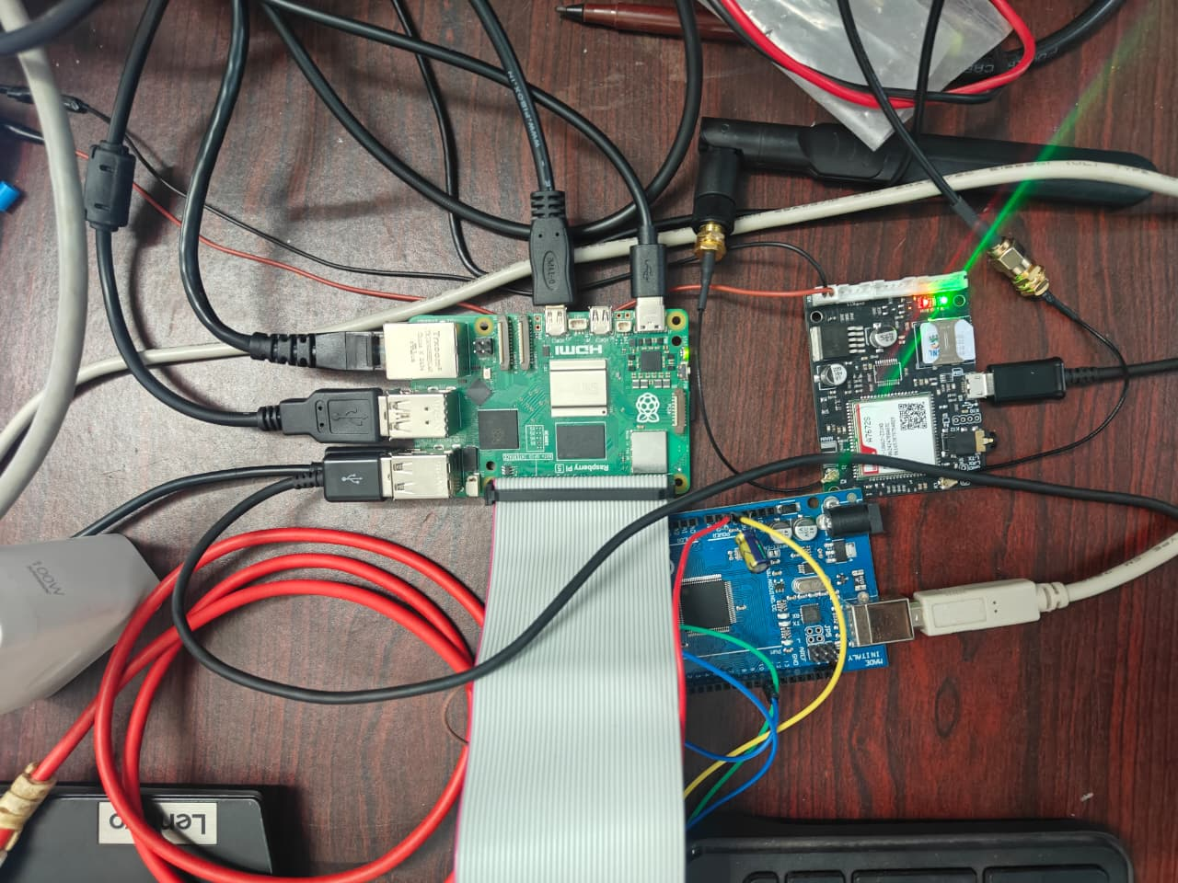
Fig – 1. HARDWARE ARCHITECTURE

Slide 8
SENSORS USED
Carbon Monoxide (CO) Sensors – 2 Units Detect and measure the concentration of carbon monoxide gas in parts per million (ppm) to identify toxic gas exposure.
Carbon Dioxide (CO₂) Sensor Monitors carbon dioxide levels in the environment to assess air quality and ventilation conditions.
Temperature Sensor Measures the surrounding environmental temperature for safety monitoring.
Altitude Sensor Determines elevation or atmospheric pressure–based altitude to monitor environmental conditions.
Pulse Sensor Measures the heart rate of the user in beats per minute (BPM) for basic health monitoring.
SpO₂ Sensor Measures blood oxygen saturation level to evaluate respiratory health.
GPS Module Provides real-time geographic location coordinates for tracking and emergency response.

Slide 9
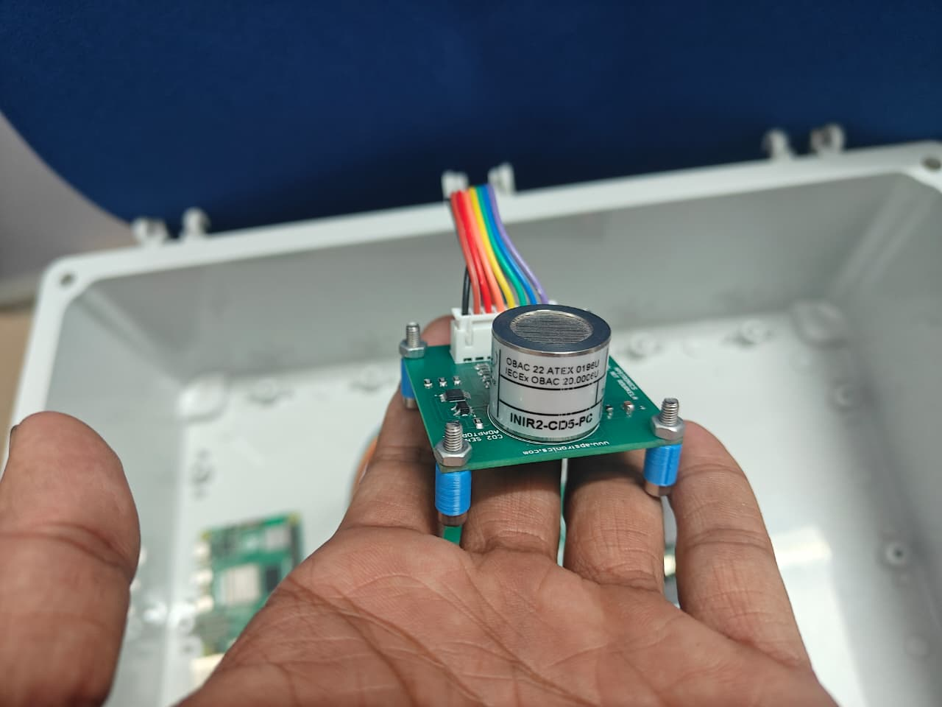
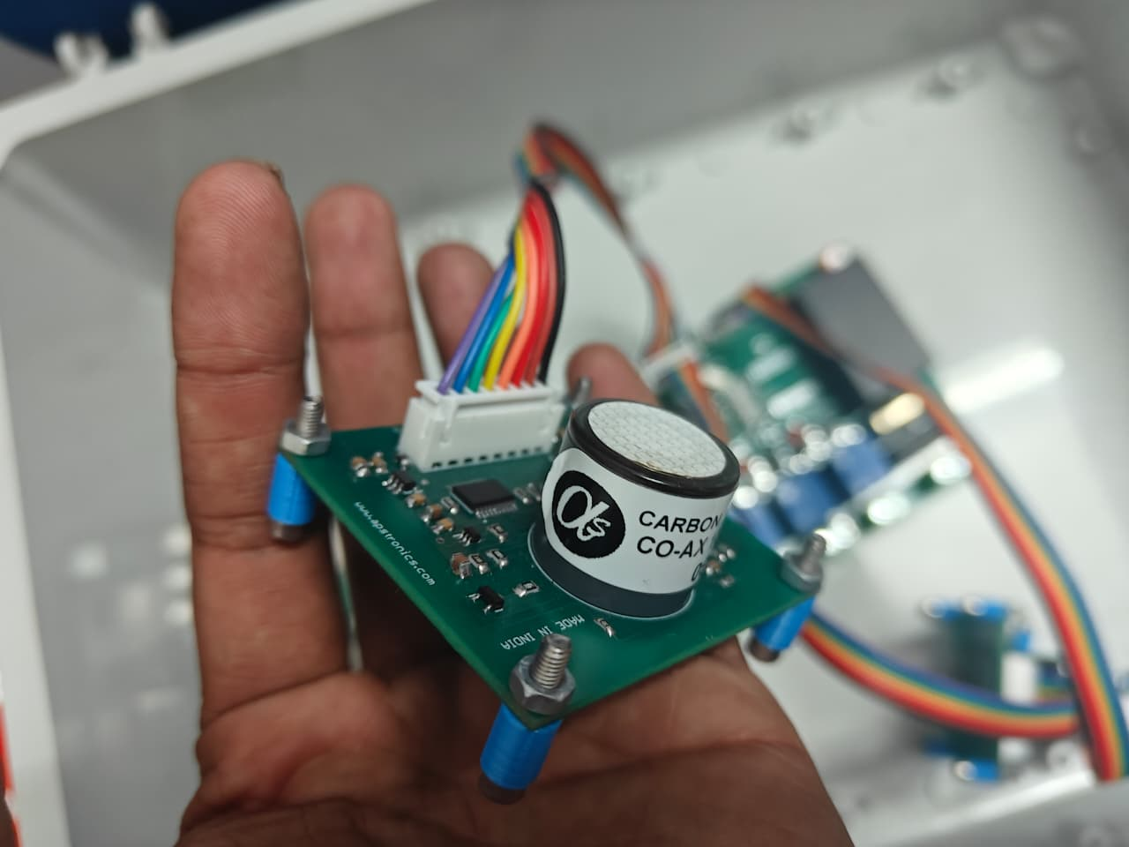
Fig -2. CO2 SENSOR
Fig -3. CO SENSOR

Slide 10
CUSTOM PCB DESIGN
Custom-designed Printed Circuit Board (PCB) is developed to integrate all system components into a single compact board.
Includes the microcontroller, sensor interface circuits, power supply regulation, relay output circuits, and a communication module.
The PCB allows easy connection of different sensors used for environmental and health monitoring.
Ensures stable power distribution and reliable signal transmission between components.
Board collects sensor data and sends it to cloud system for monitoring and analysis.

Slide 11
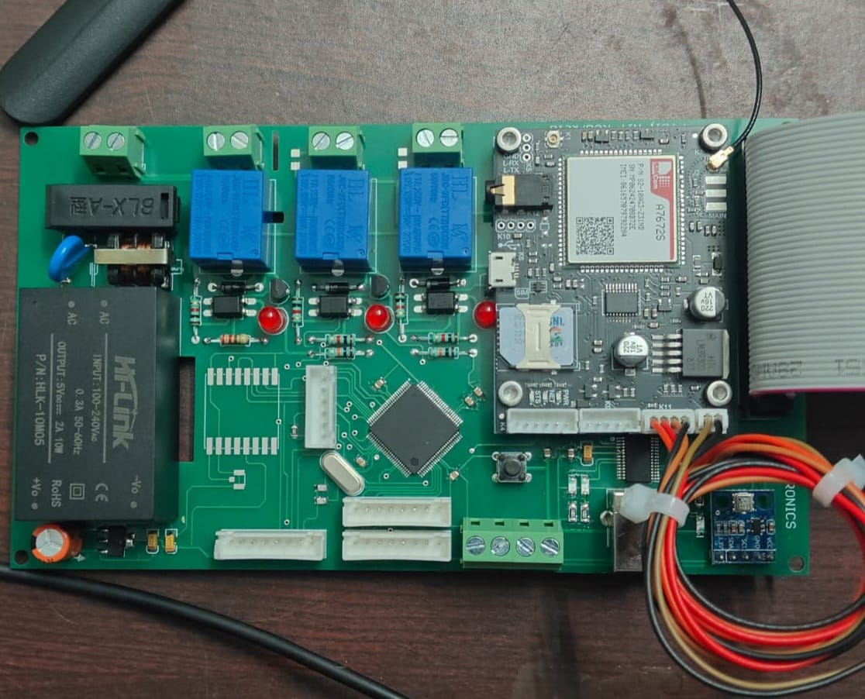
Fig – 4. MOTHER BOARD

Slide 12
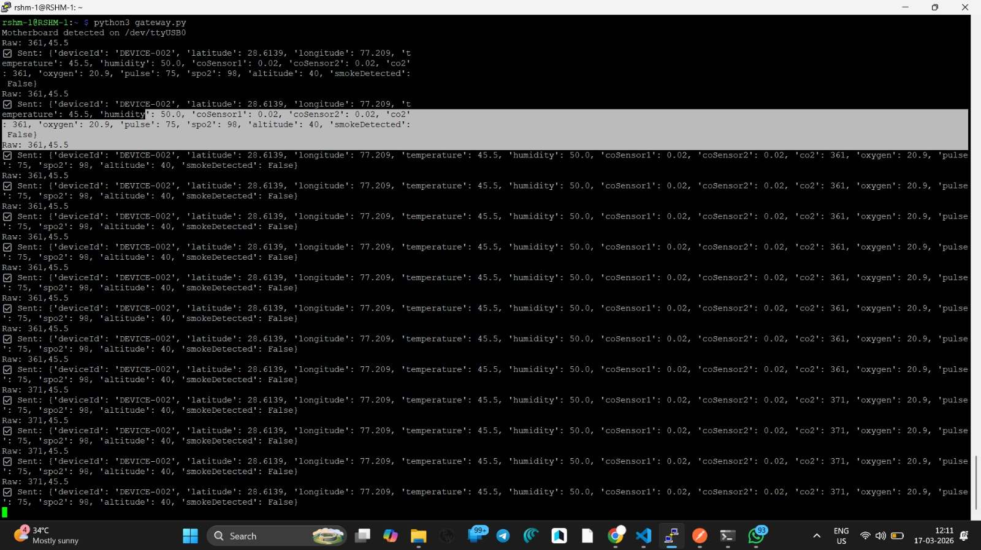
IOT GATEWAY
The gateway device used in the system is Raspberry Pi 5, which acts as the central communication unit.
It receives sensor data from the custom embedded PCB and connected sensors.
The device processes and formats the collected data before sending it further.
It transmits the data to the backend/cloud server through internet connectivity.
Acts as a bridge between the hardware system and cloud services, enabling real-time monitoring and data management.
Fig – 5. DATA SENT TO BACKEND

Slide 13
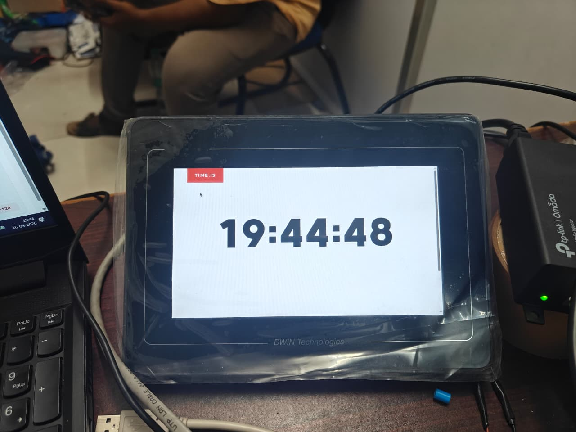
DISPLAY SYSTEM
A capacitive touch display from DWIN Technologies is connected to the Raspberry Pi device.
The display runs a web browser in kiosk mode to automatically open the monitoring dashboard.
Sensor data is displayed continuously without user interaction.
Enables real-time visualization of environmental and health parameters.
Allows users to monitor system status directly at the device location.
Fig -6. DISPLAY UNIT

Slide 14
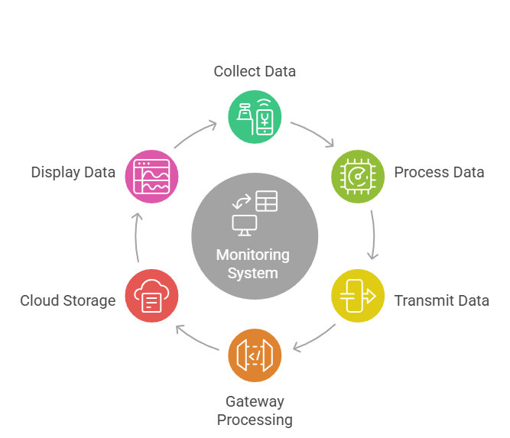
COMMUNICATION FLOW

Slide 15
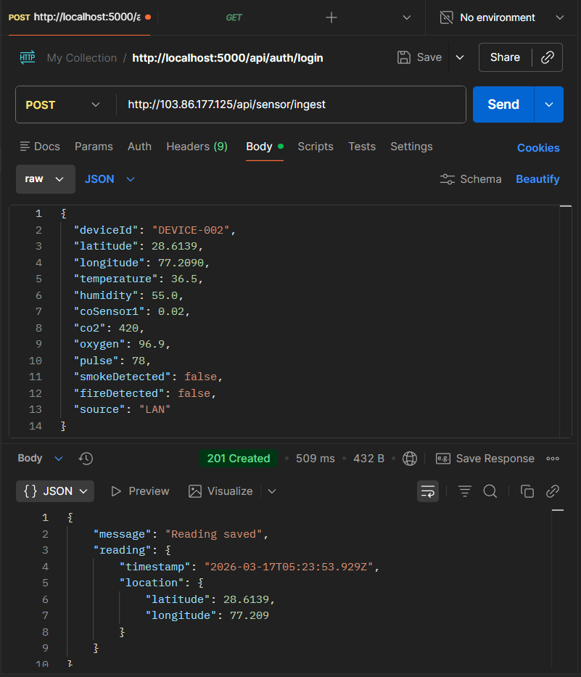
DATA TRANSMISSION FORMAT
Sensor readings are transmitted to the server in JSON (JavaScript Object Notation) format.
The JSON structure contains device identification and multiple sensor parameters.
Each data packet includes environmental data (temperature, CO, CO₂, altitude) and health data (pulse rate, SpO₂).
Location coordinates (latitude, longitude and altitude) are also included for device tracking and monitoring.
Fig -7. DATA FORMAT (JSON)

Slide 16
BACKEND ARCHITECTURE
The backend system is developed using Node.js and the Express.js framework to handle communication between the IoT gateway and the dashboard.
Key Functions of the Backend:
Receive sensor data from the IoT gateway device
Process and validate the incoming data
Store the processed data in the MongoDB database
Provide REST APIs for the frontend dashboard to retrieve data

Slide 17
DATABASE SYSTEM
MongoDB is used as the primary NoSQL database for storing system data.
Stores device details, sensor readings, user authentication information, and location data.
Designed to handle continuous real-time data from multiple IoT devices.
Each sensor entry includes timestamp, device ID, environmental gas levels, and health parameters.
Data is organized into collections such as Users, Devices, Sensor Data, and Locations.
Supports fast data retrieval for the web dashboard and monitoring system.
Enables scalable storage for large volumes of IoT sensor data.
Stored data can be used for real-time monitoring, historical analysis, and safety management.

Slide 18
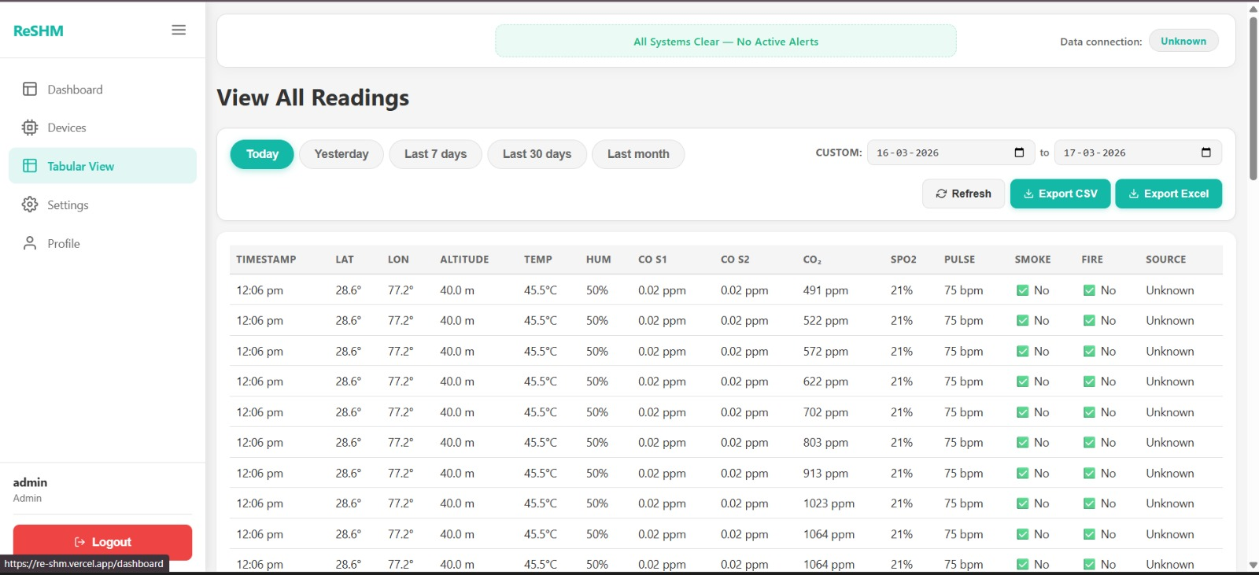
FRONTEND DASHBOARD
Developed using the MERN Stack (MongoDB, Express.js, React.js, Node.js) to provide a scalable and responsive web interface.
Displays real-time sensor data and device status, allowing users to continuously monitor environmental gases and health parameters.
Provides graphical visualization of sensor readings such as gas levels, temperature, and health metrics for better understanding of system conditions.
Includes room-based monitoring and alert notifications, enabling quick detection of hazardous situations and improving safety management.
Fig – 8. DATASETCHED FROM CLOUD

Slide 19
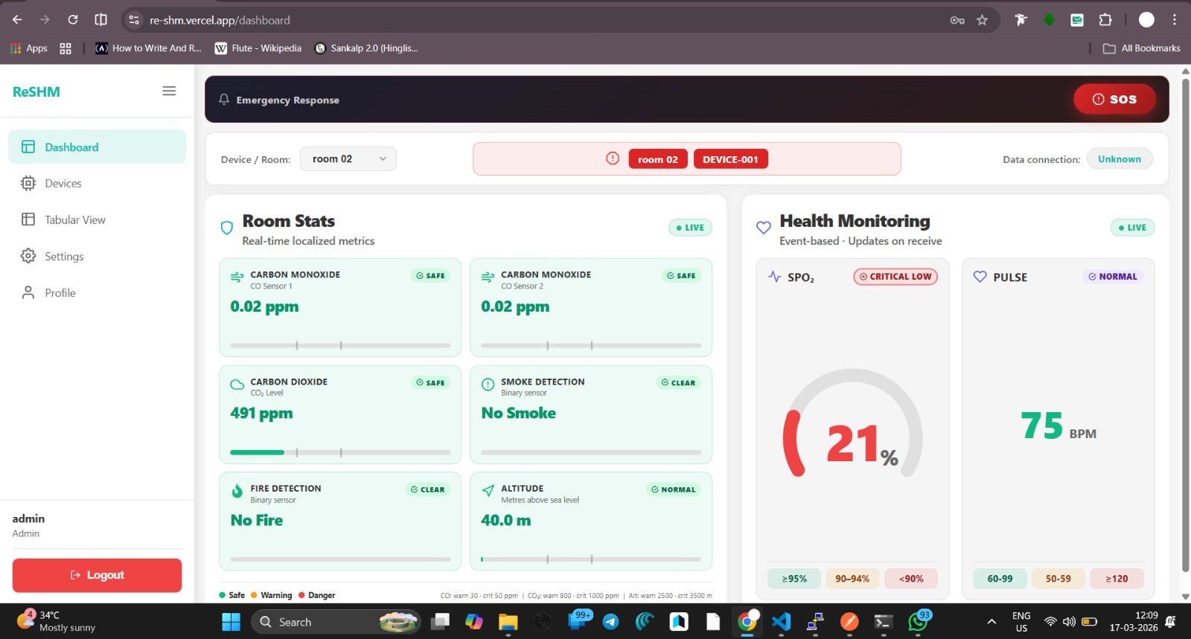
DASHBOARD FEATURES
Displays real-time monitoring of environmental parameters such as Carbon Monoxide (CO), Carbon Dioxide (CO₂), smoke levels, and fire detection.
Shows health parameters including pulse rate and SpO₂ levels to monitor the physical condition of individuals in hazardous environments.
Provides additional system data such as altitude and room-based monitoring status for location-based safety tracking.
Includes emergency alerts and response indicators to quickly notify users when dangerous conditions are detected.
Fig -9. DASHBOARD

Slide 20
CLOUD DEPLOYMENT
The frontend dashboard is deployed on Vercel, ensuring fast global access and reliable web hosting.
The backend application runs on a VPS server, where the Node.js and Express.js API processes incoming IoT data.
The VPS also hosts the MongoDB database, which stores sensor readings, device information, and user data.
PM2 is used as a process manager to keep the backend services running continuously and automatically restart them if failures occur.

Slide 21
REAL-TIME MONITORING
The system continuously collects and transmits sensor data to the cloud server in real time.
The dashboard displays live readings of environmental gases and health parameters.
Safety conditions are categorized as Safe, Warning, and Danger based on sensor thresholds.
Real-time alerts and indicators help users quickly detect and respond to hazardous situations.

Slide 22
APPLICATIONS
Industrial Safety Monitoring – Detects harmful gases and environmental hazards in factories to protect workers.
Mine Safety Systems – Monitors gas levels, worker health, and location in underground mines.
Hospital Patient Monitoring – Tracks vital signs like pulse rate and SpO₂ for continuous patient observation.
Environmental Monitoring – Measures air quality parameters such as CO and CO₂ in different environments.
Smart Building Safety – Detects smoke, fire, and unsafe conditions in buildings for early warning and safety alerts.

Slide 23
ADVANTAGES
Real-time Monitoring – Continuously tracks environmental and health parameters with instant updates.
Remote Accessibility – Data can be monitored from anywhere through a web dashboard.
Centralized Safety Monitoring – All sensor data is collected and managed in a single system.
Low-Cost IoT Architecture – Uses cost-effective hardware and cloud technologies.
Scalable System Design – Additional sensors and devices can be easily integrated into the system.

Slide 24
FUTURE IMPROVEMENTS
Mobile Application Integration – Develop a mobile app for real-time monitoring and alerts.
AI-Based Anomaly Detection – Use AI to automatically detect abnormal sensor patterns and predict hazards.
Advanced Health Monitoring Sensors – Integrate additional sensors for more detailed vital-sign monitoring.
Emergency Response Integration – Connect the system with alarms and emergency services for faster response.

Slide 25
CONCLUSION
The ReSHM system integrates IoT, embedded systems, and cloud technology for real-time monitoring.
It continuously collects environmental and health data from multiple sensors.
The system enables remote monitoring through a web dashboard.
It improves safety by providing early detection of hazardous conditions.
The design is scalable, reliable, and suitable for industrial and safety applications.

Slide 26
THANK YOU

